Slide 1
UA ASCEND
Fall 2017/Spring 2018 Launch Results
Claudio Cerrillo, Duffy Elmer, Kenrick Encinas, Shobitha Jillella, Cathy McIntosh, Arjun Muralidaran, Andrew Okonya, Joel Thibault, Andras Szep, Joshua Smith and Marton Szep

Slide 2
Payload Design
Design planning and CAD
Fabrication
Dynamic and Stress Analysis

Slide 3
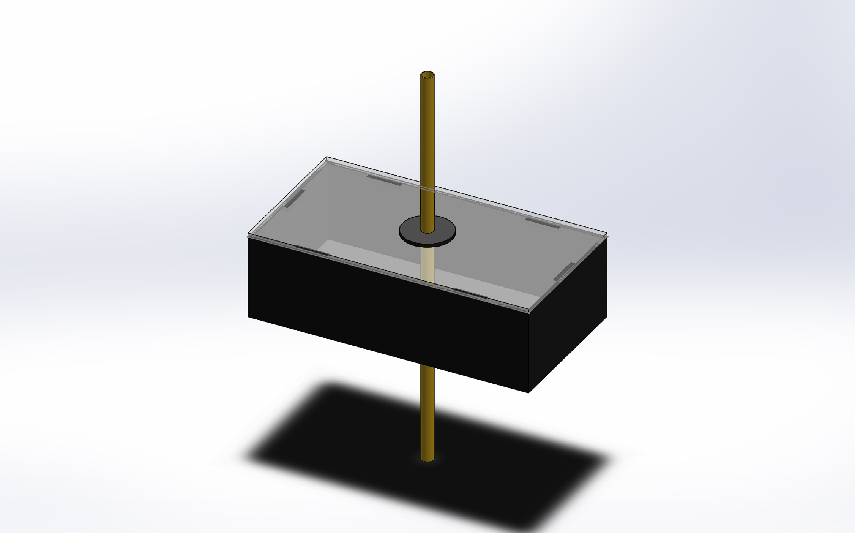
Design Planning and CAD
Fall 2017 Assembly
Solid Construction
Simple build materials
3D printed reinforcements

Slide 4
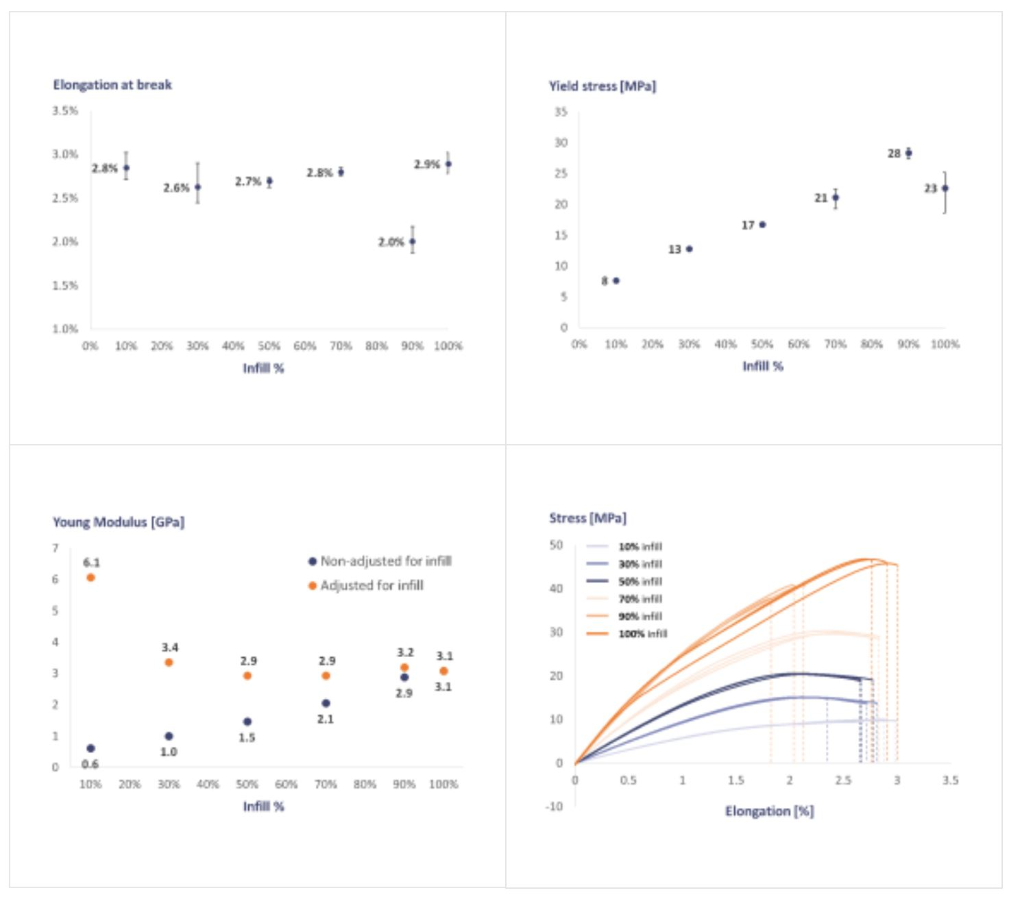
Design Planning and CAD
Considerations
Weight
Infill
Layer height
Accuracy

Slide 5
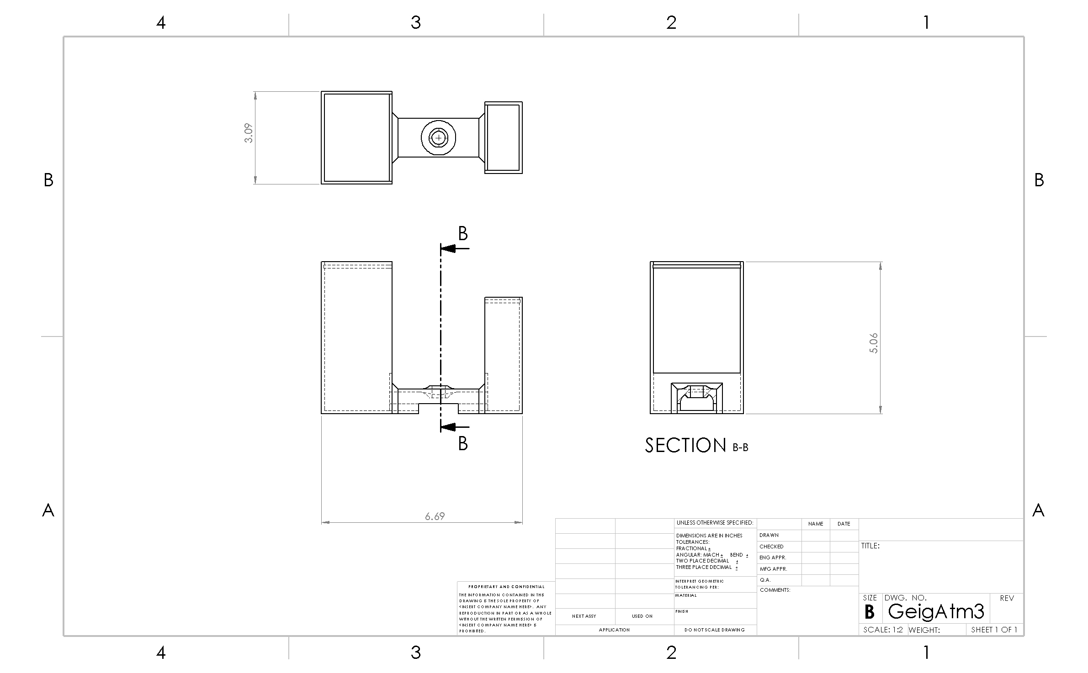
Design Planning and CAD

Slide 6
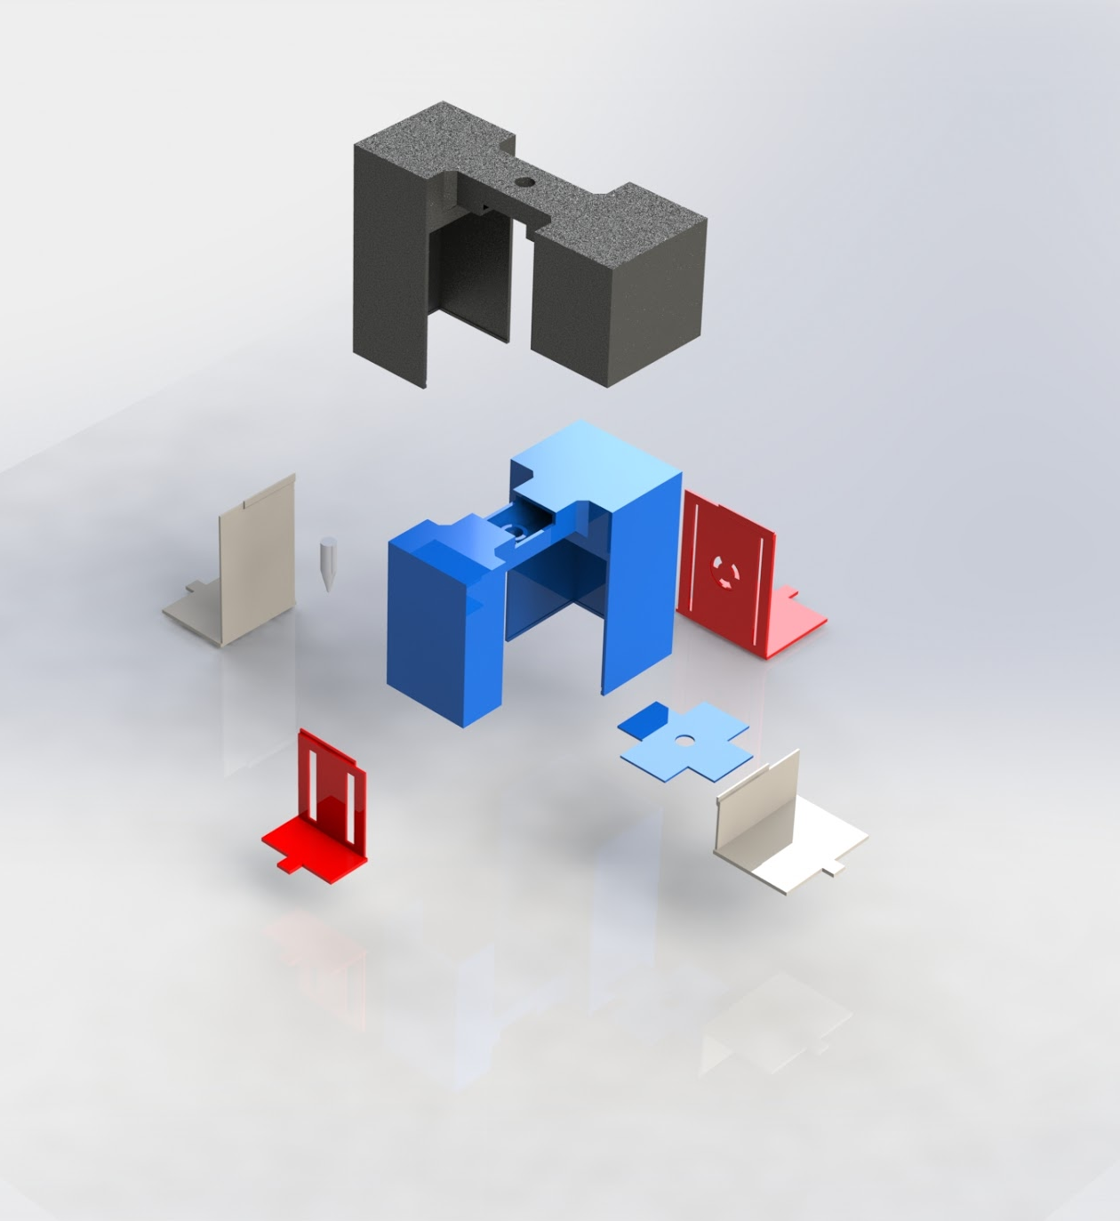
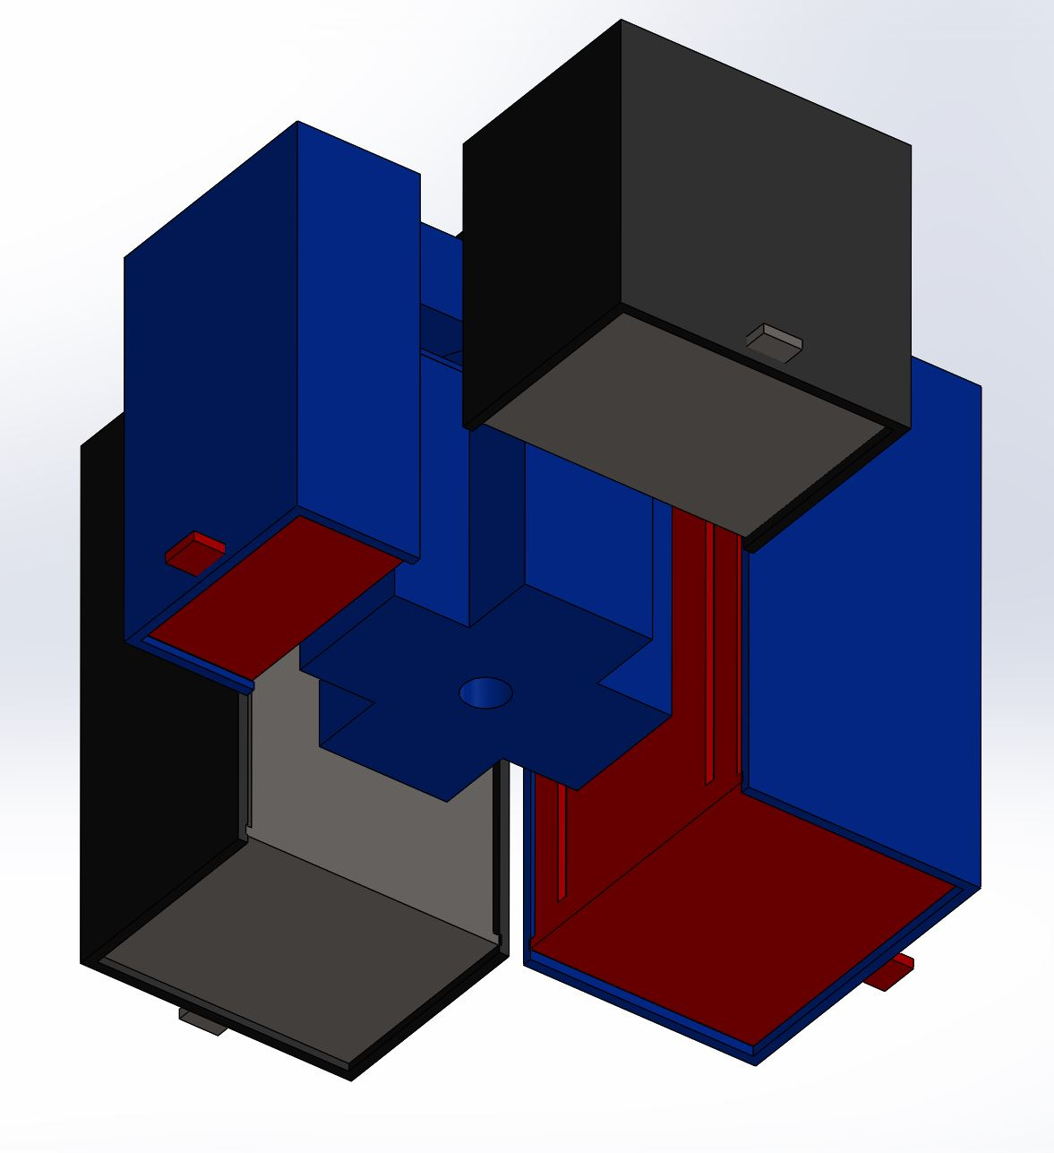
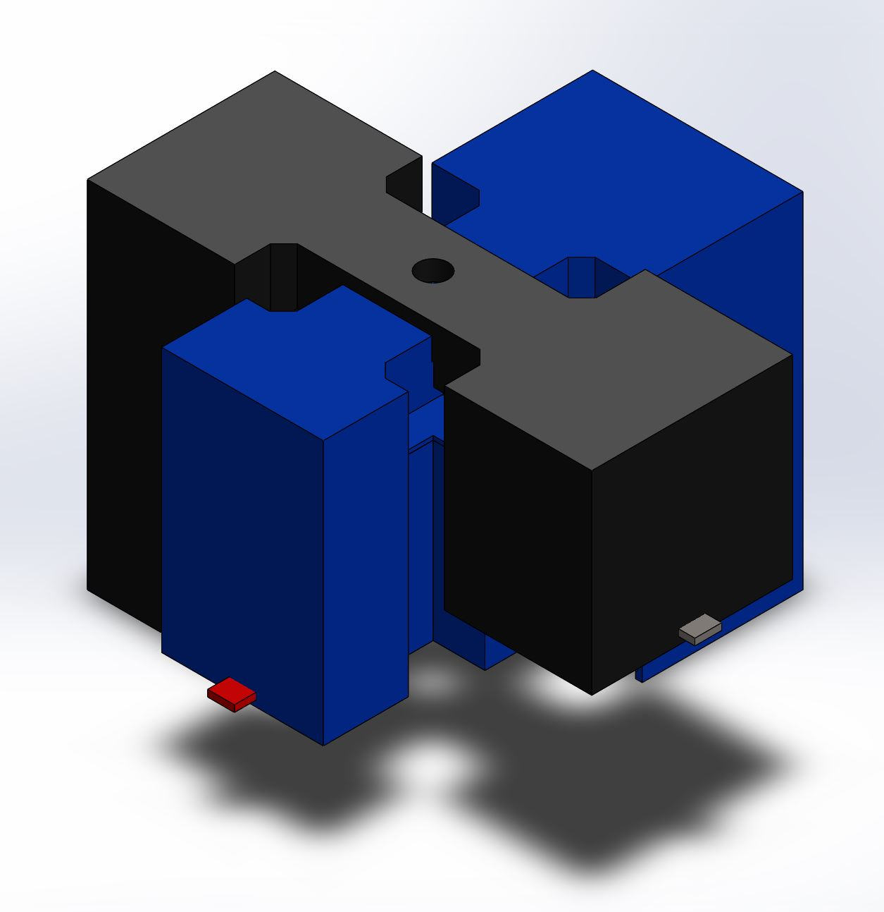
Design Planning and CAD
Spring 2018 Assembly
Light weight
Easy to standardize
Fully 3D Construction

Slide 7
Comparison Between Launch Payloads
Fall
Simple construction- well tested
For new members to learn construction basics
Quick design, over-built
Spring
Standardized and scalable
More pre-planning, meant to house for specific experiment

Slide 8
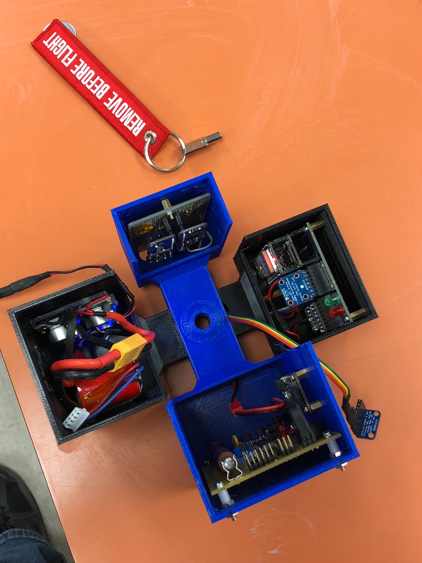
Fabrication and Design Integration
Primary Goals
Assembly
On-hands experience for new members
CAD
Tools
Materials

Slide 9
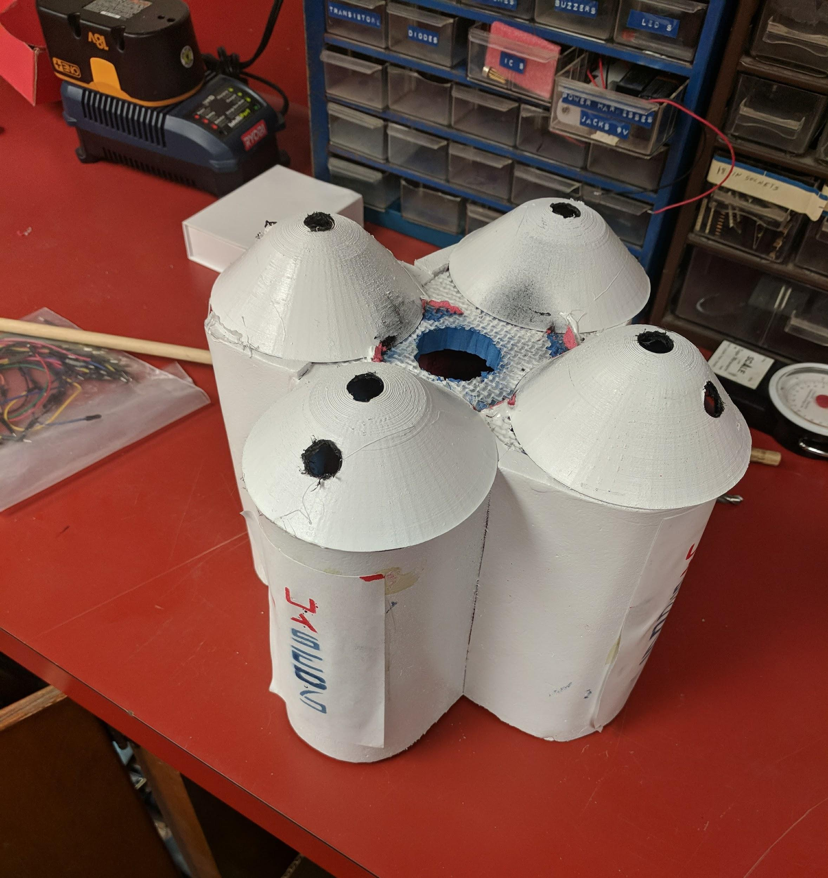
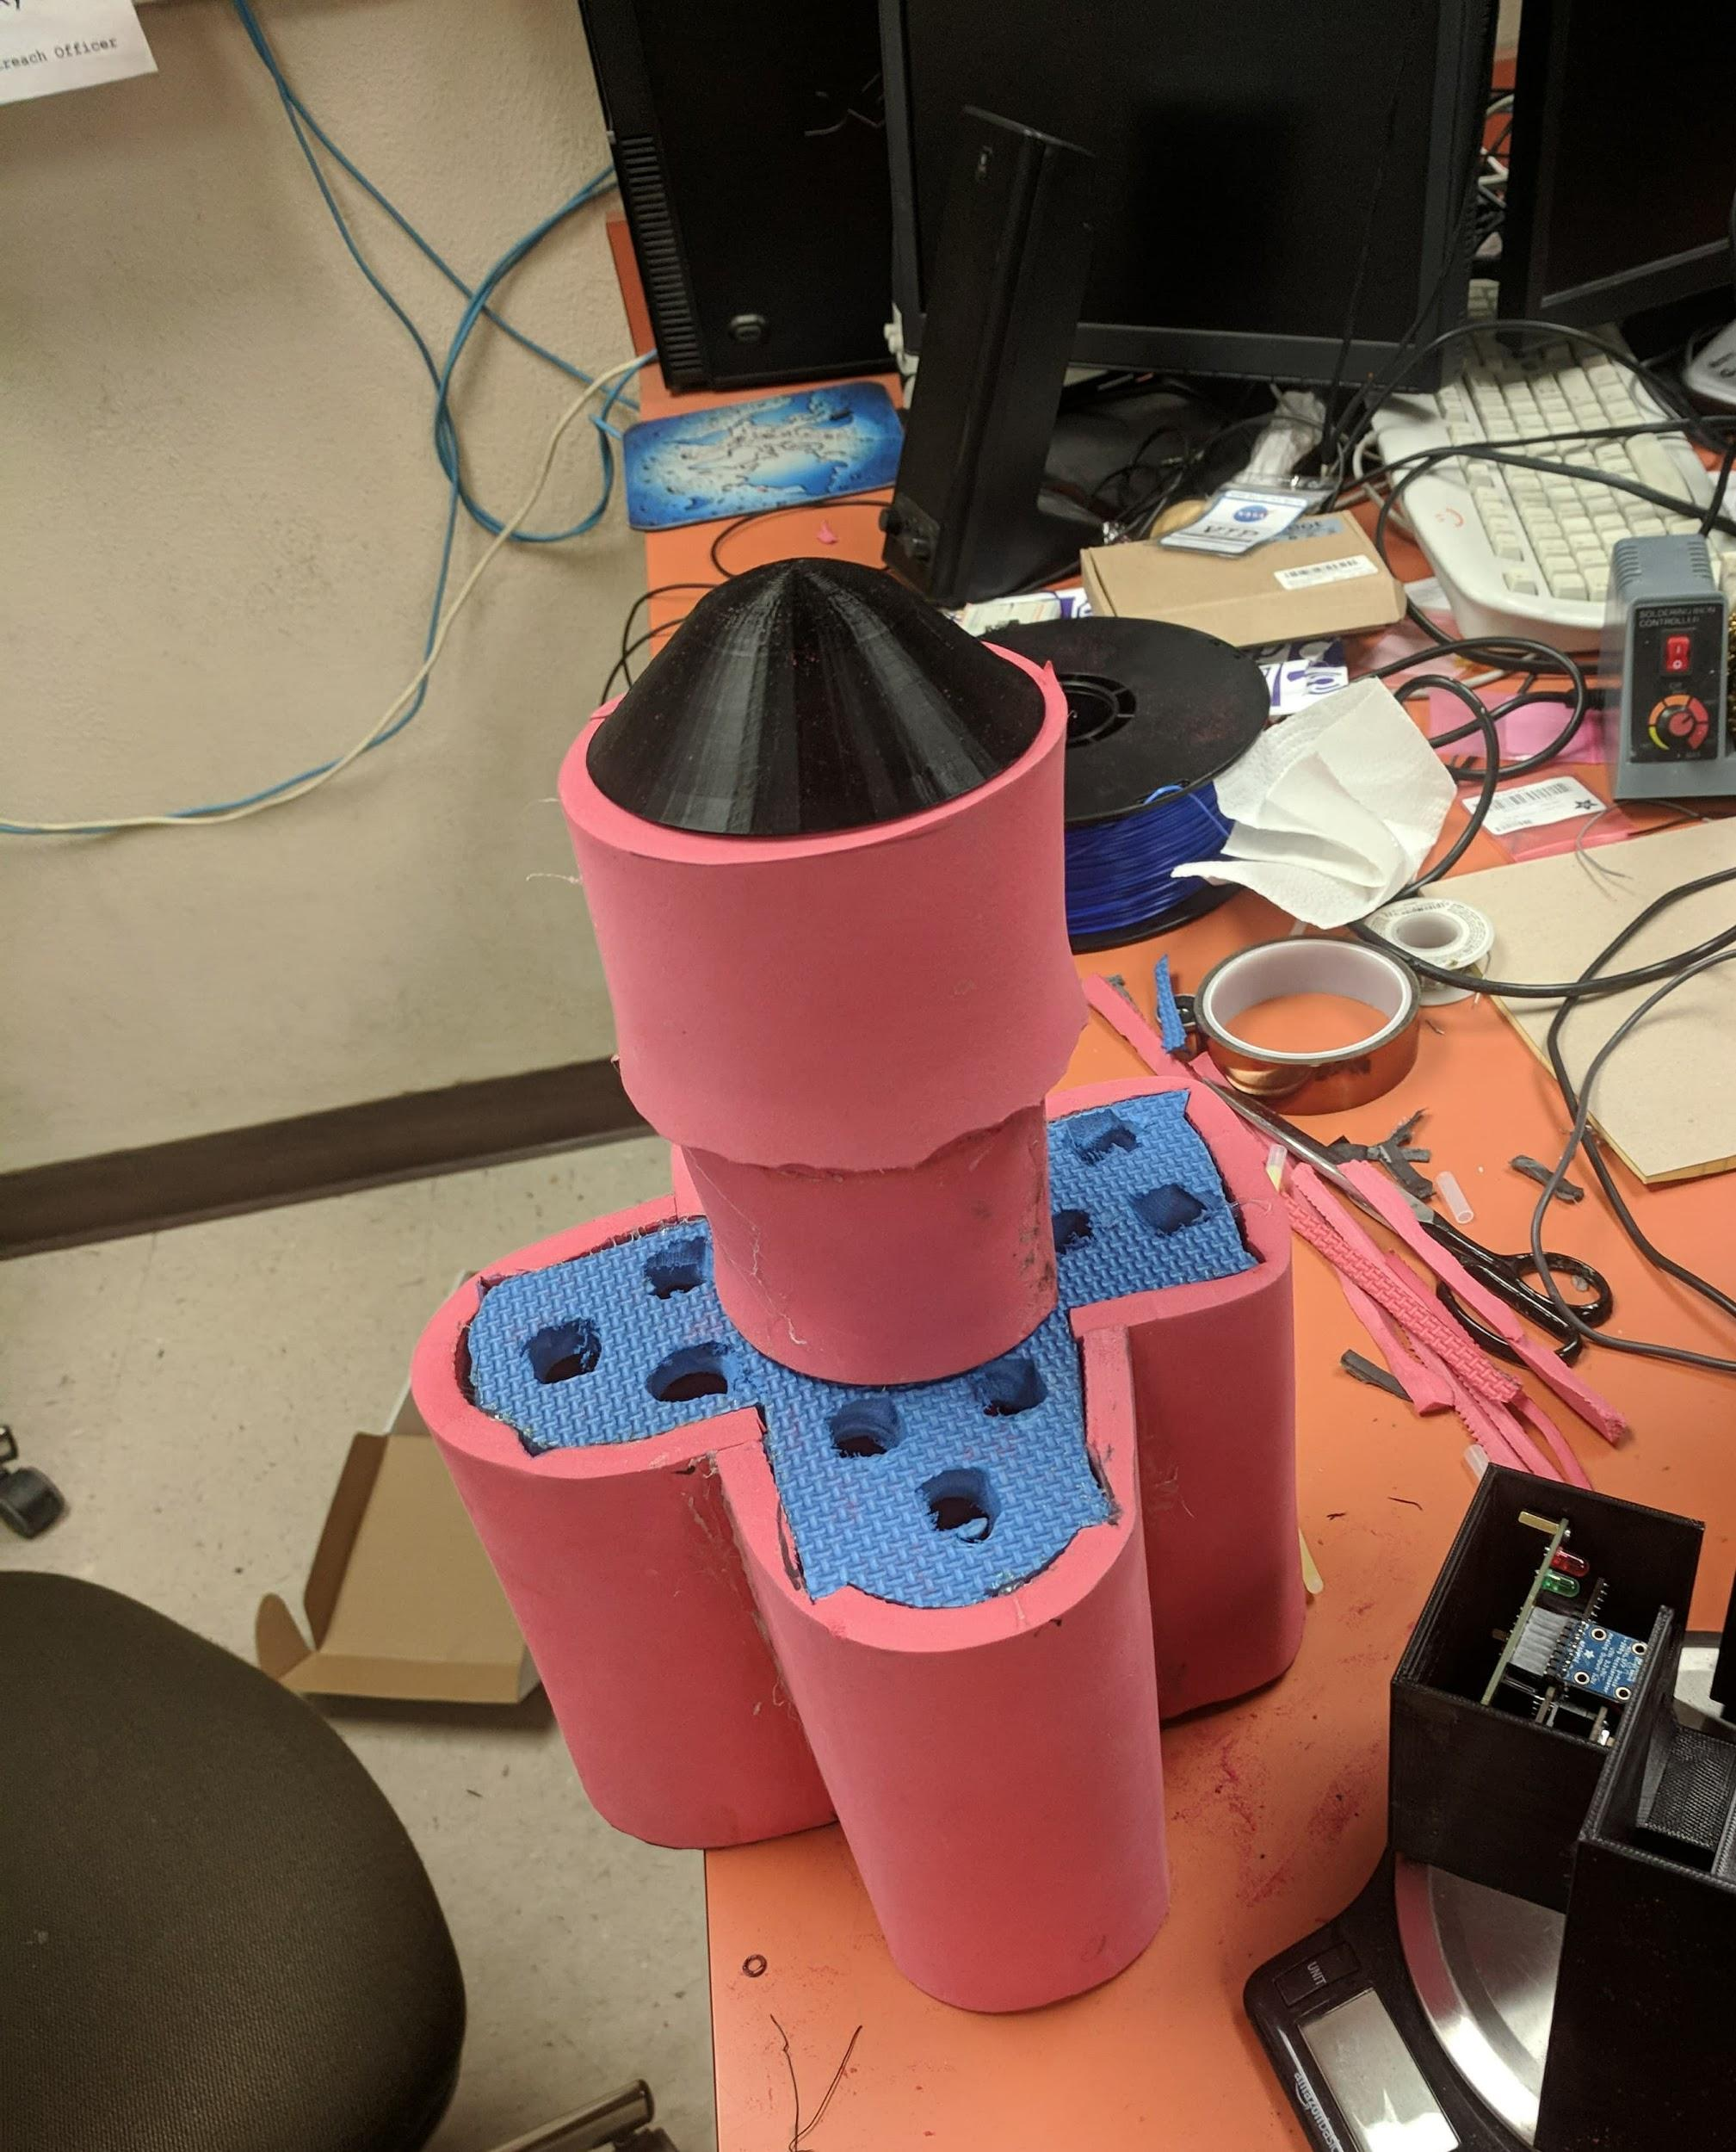
Fabrication and Design Integration
Outer Shell
EVA Foam
Cost effective
Easy to mold
Insulation
Shock absorption
3D-Printed Components

Slide 10
Fabrication and Design Integration
Cones
Apply Knowledge to Project Applications
Real world CAD applications
Fit and model an Outer shell to protect and look like SpaceX Falcon Heavy
Learned How To…
Use Certain tools
How apply Paint to fit our design
Stencil and 3D Printing
Solidworks applications
Learned How To…
Apply Graphic Design to CAD
Utilizing Autotrace
Optimize infill for efficiency and integrity

Slide 11
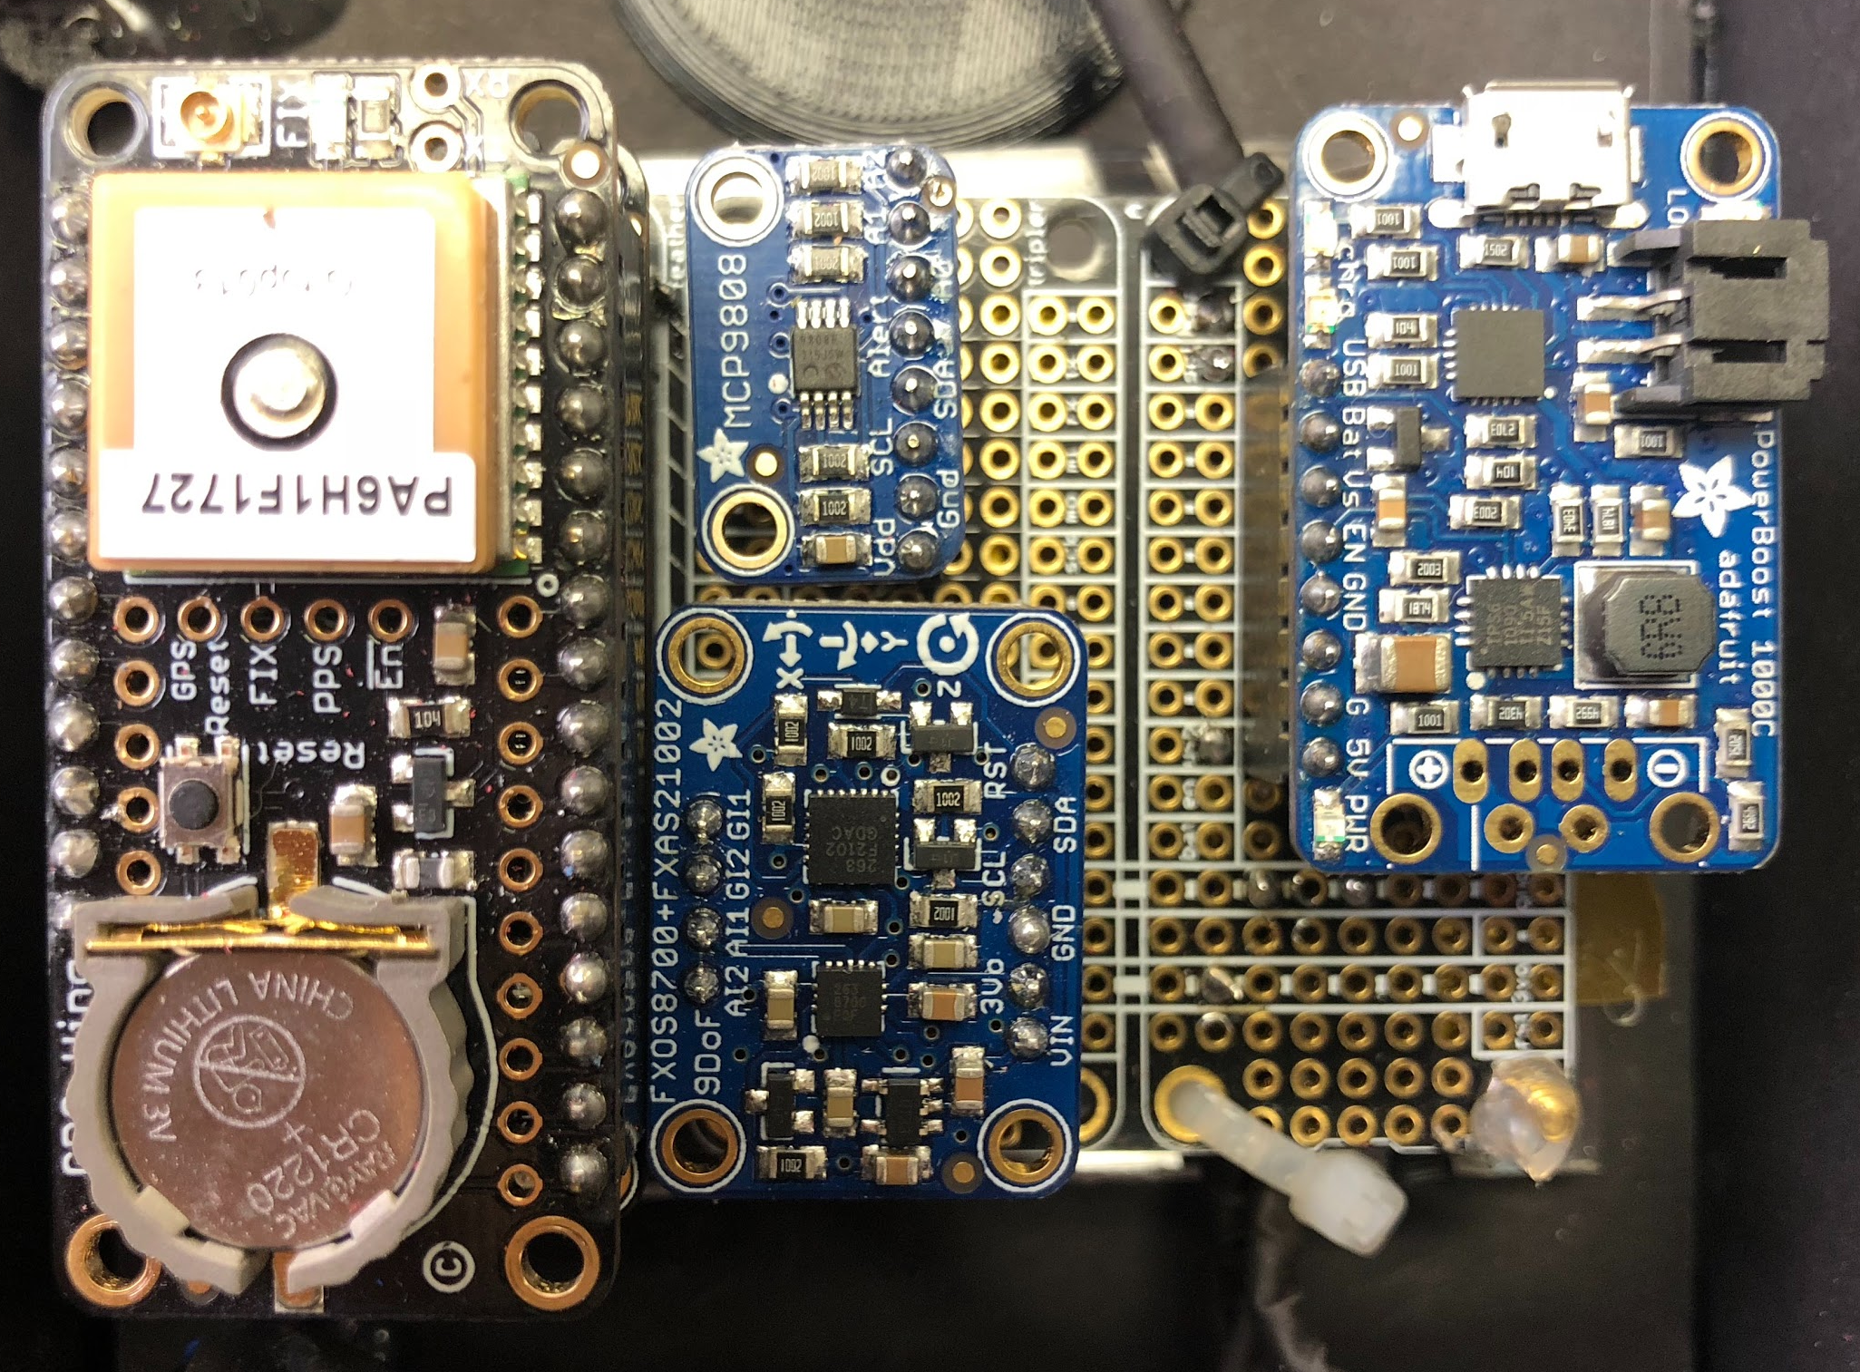
Electronics
General Fall 2017 Data-Logger Specs:
Feather M0 Datalogger
9DOF Sensor
BME280 Temperature, Pressure and Humidity
MCP9808 High Accuracy Temperature

Slide 12
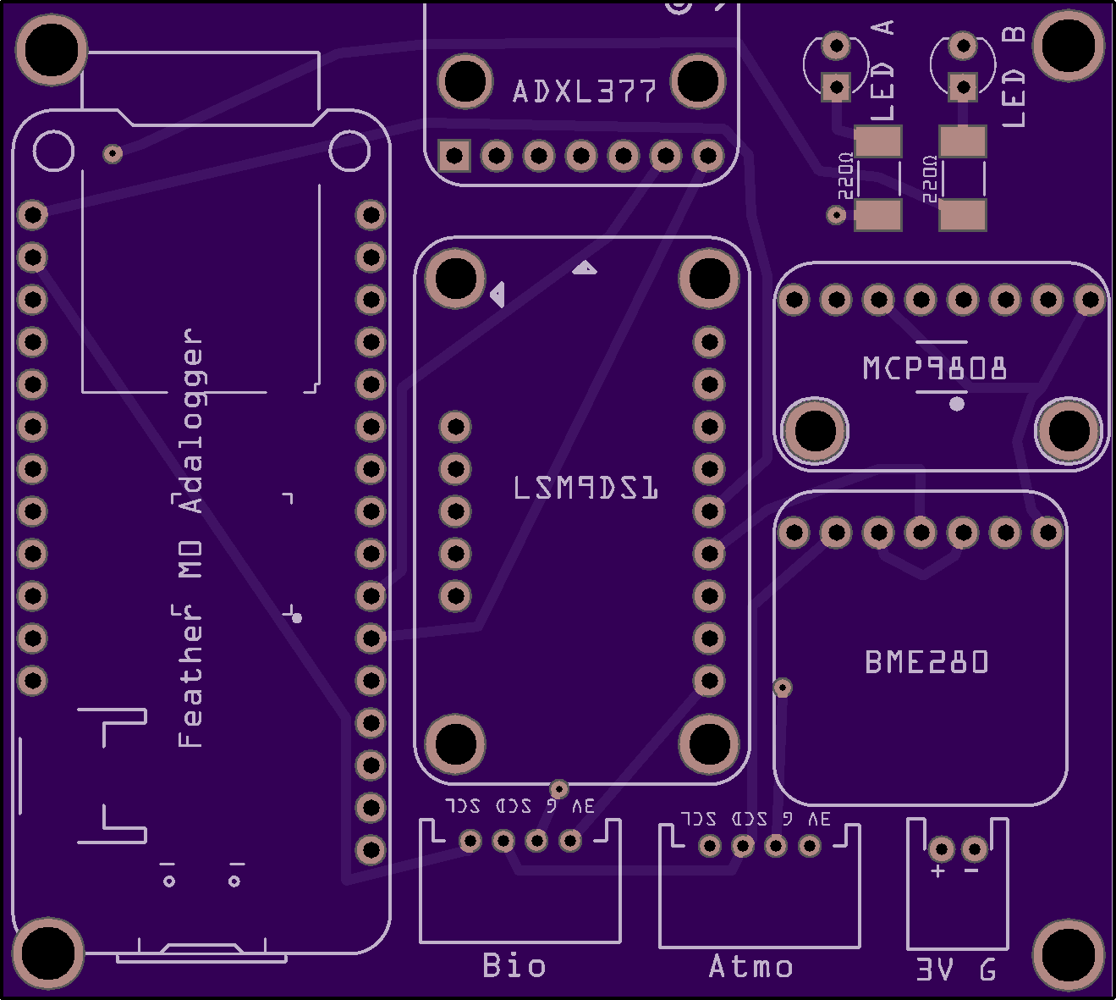
Electronics
General Spring 2018 Data-logger Specs:
Feather M0 Datalogger
9DOF Sensor
BME280 Temperature, Pressure and Humidity
MCP9808 High Accuracy Temperature
ADXL377 High G Accelerometer

Slide 13
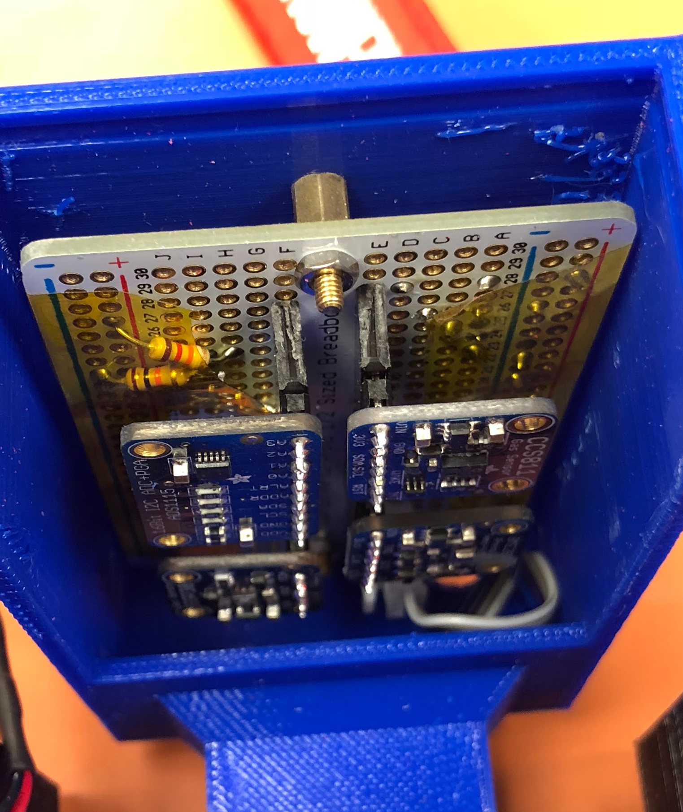
Electronics
Atmospheric Specs:
BME280 Temperature, Pressure and Humidity
SGP30 Air Quality Sensor
CCS811 Air Quality Sensor

Slide 14
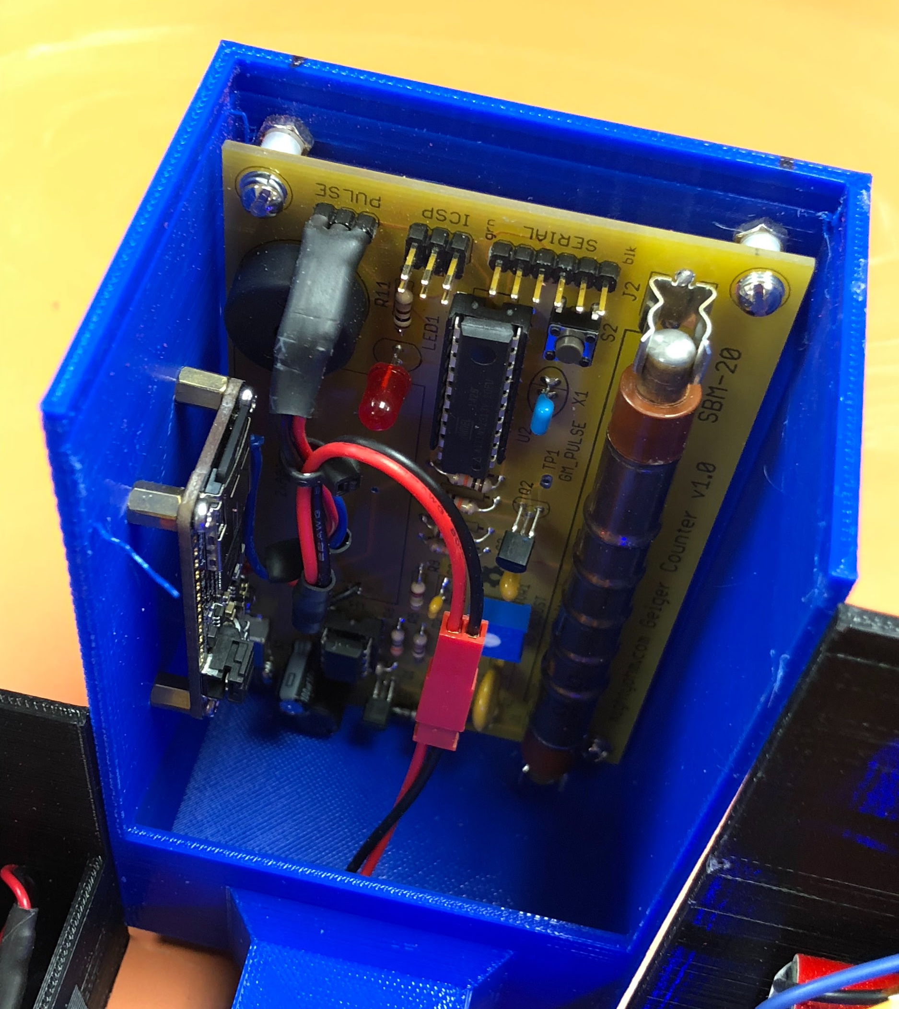
Geiger Counter
Geiger Counter Specs:
MightyOhm Geiger Counter
Feather M0 Datalogger

Slide 15
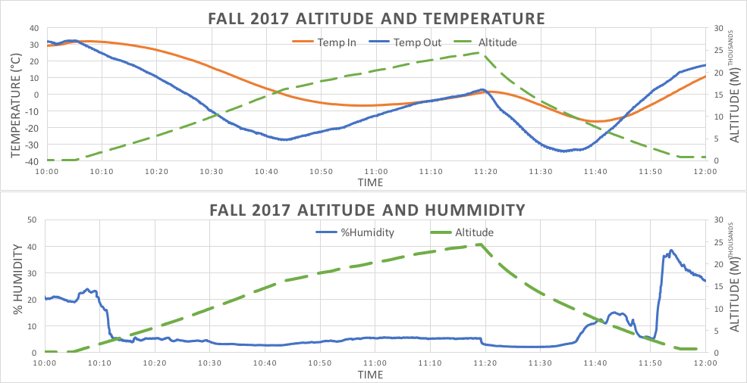
FALL 2017 DATA

Slide 16
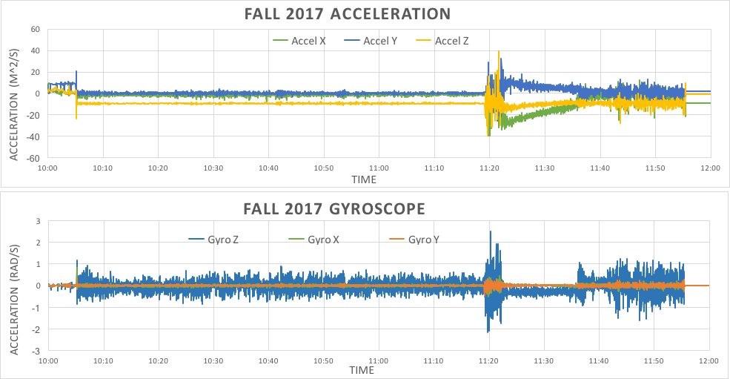
FALL 2017 DATA

Slide 17
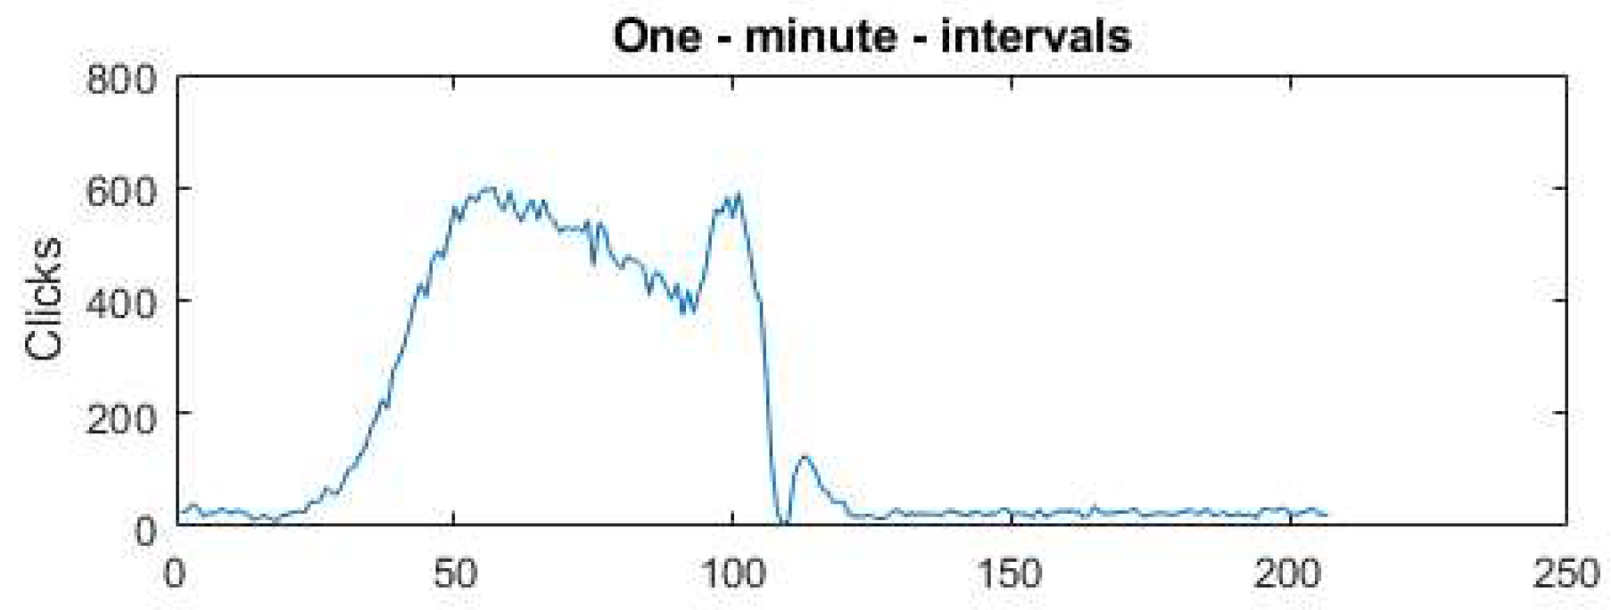
Geiger Data
Clicks
Time
(Minutes)

Slide 18
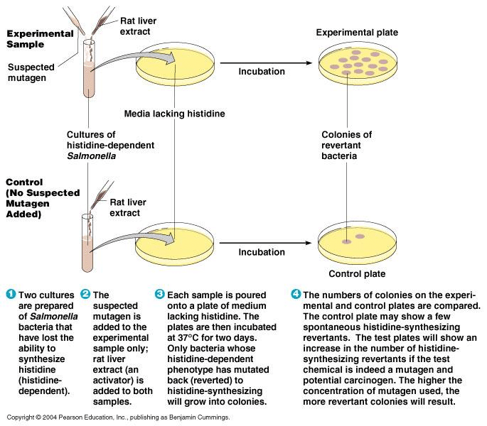
Life Sciences Experiment
Objectives
Measuring effects of ionizing radiation on Salmonella enterica via the Ames mutagenicity assay.
Providing proof of concept and conducting a test flight in preparation for the AZSGC RockSat-C mission launching in June 2018.

Slide 19
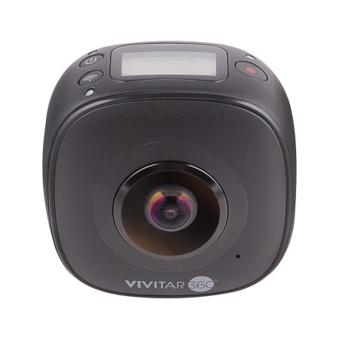
Vivitar 360 Camera
Full 360° horizontal x 240° vertical field of view
4K: 2880 x 2880 @ 30FPS Max
Accelerometer, E-Compass, Non-Assisted GPS, Gyroscope, Microphone
Up to 1.5 hours battery life
~109g weight
Dust & shock resistant
Internal 64GB storage

Slide 20
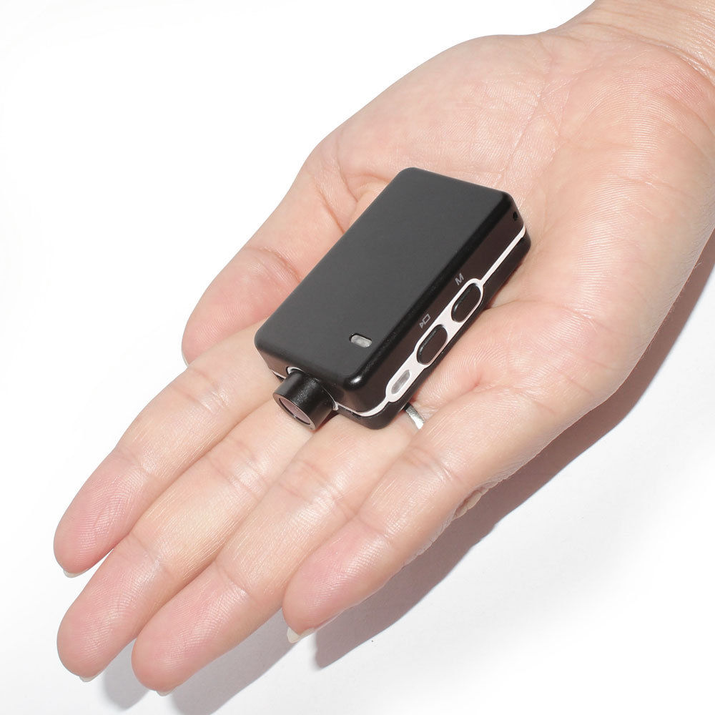
Mobius Mini 1080p
Fixed one-directional camera
Records at 1080p 60 FPS
Mounted on a metal bar that acted as a heat sink
Goal was to keep the mobius cool enough to capture balloon pop
Only weighs 27 grams

Slide 21
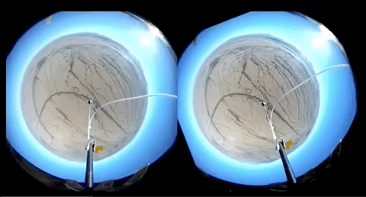
360 Camera Footage

Slide 22
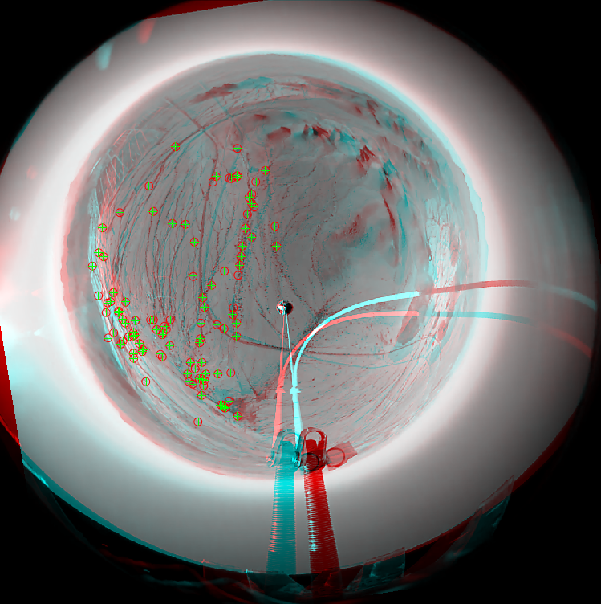
360 Camera Stabilization
Masking
Feature identification
Feature matching
Rotational correction

Slide 23
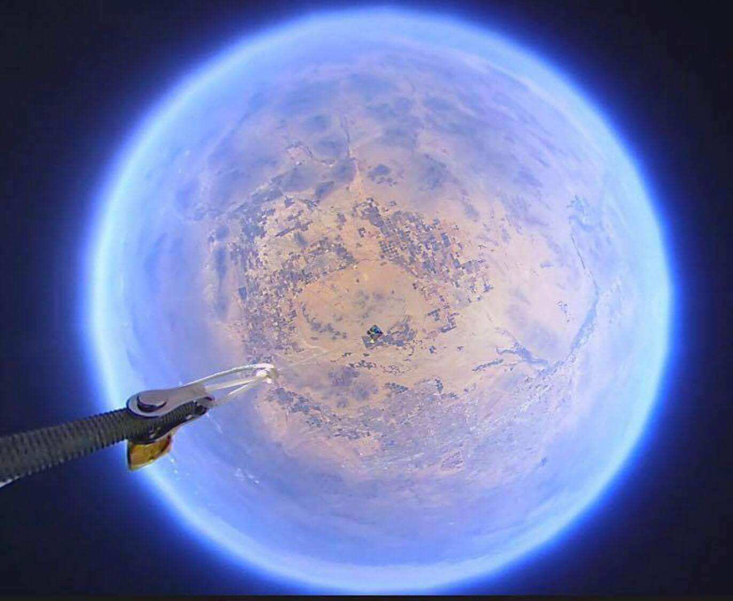
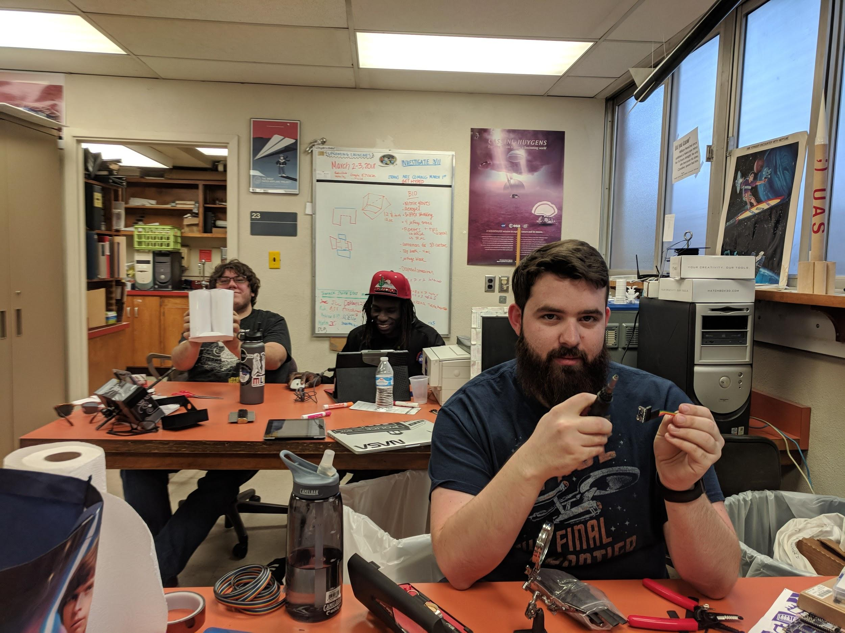
Thank You
Susan Brew,
Arizona Near Space Research,
NASA Space Grant,
Arizona Space Grant Consortium

